Slide 1
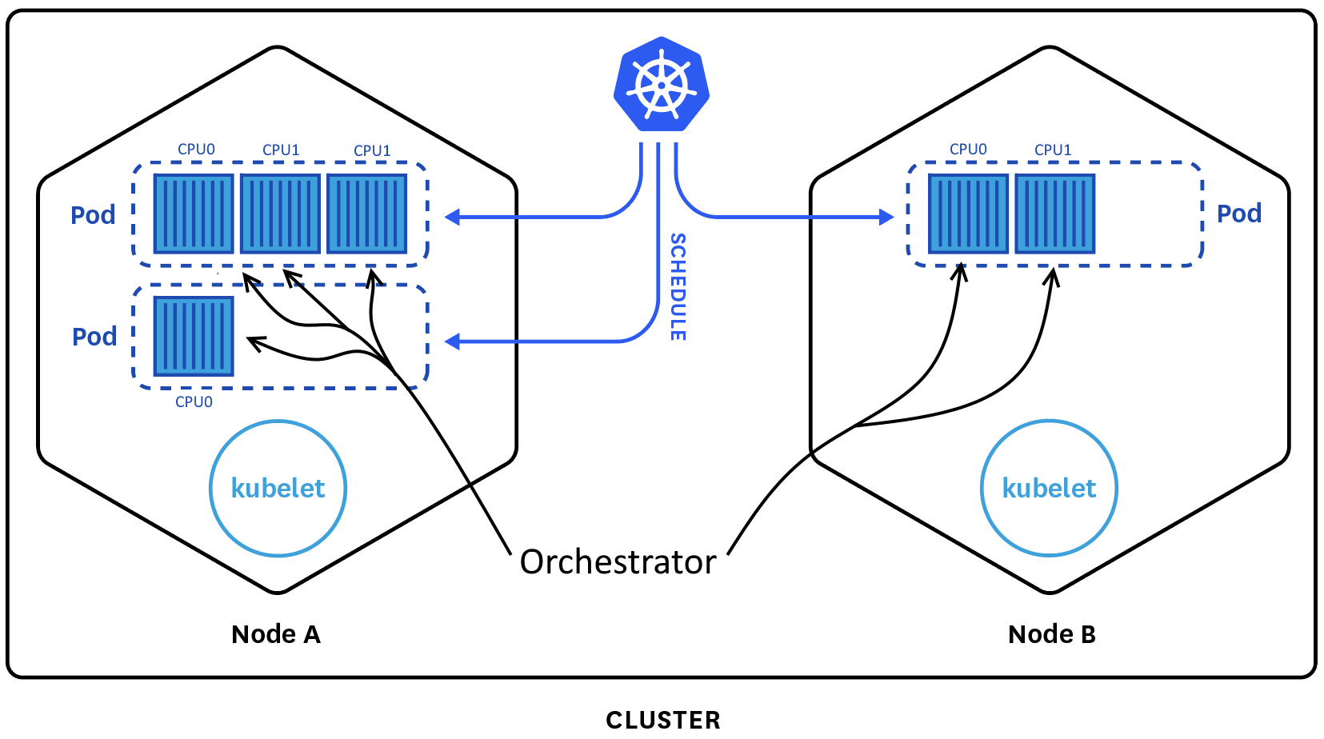

Comparison Kubernetes vs. Orchestrator
Kubernetes:
Allocates pods (and their containers) on nodes based on the required resources and/or tags
Limits the maximum CPU-time and memory of a container and a pod according to static configuration
May reallocate a pod’s container to an other node if needed
Orchestrator:
Manages containers on local resources (CPU scheduling)
Monitors real-time behavior and reallocates local resources during runtime if needed
Tries to manage CPU-time on a node while keeping low firing latency for real-time applications

